Slide 1
BME – IC Engines
Ramu Rajendran

Slide 2
Introduction
Internal Combustion Engines
Source of power for Automobile.
Need a fuel. (Petrol, Diesel, CNG etc)
Combustion of fuel produces Heat.
Heat Energy is converted to Mechanical Work.
Mechanical Work is used to move the vehicle.

Slide 3
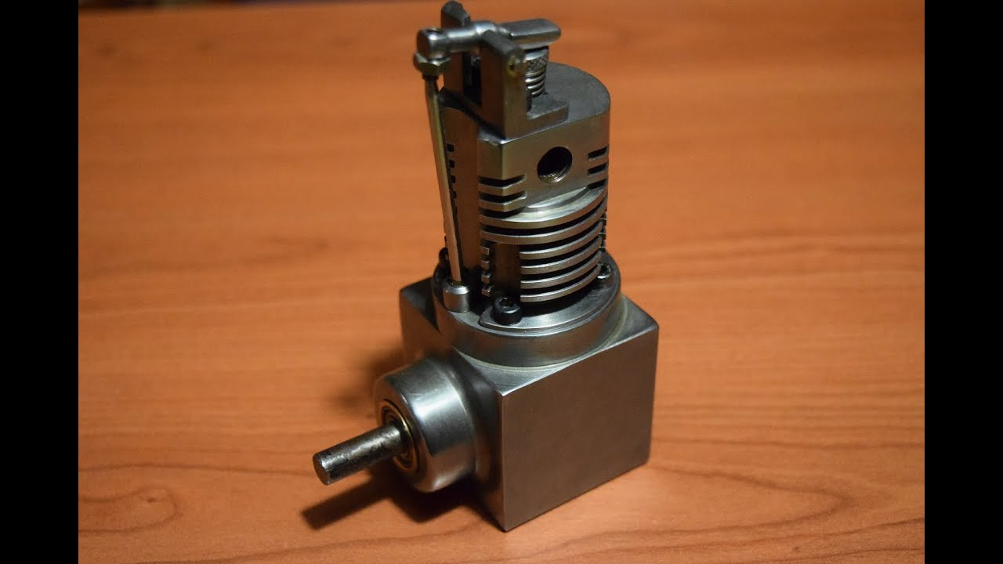

Slide 4
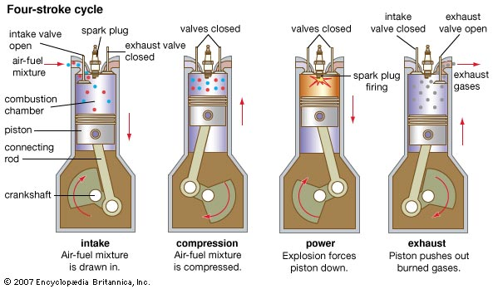

Slide 5
https://www.youtube.com/watch?v=5tN6eynMMNw

Slide 6
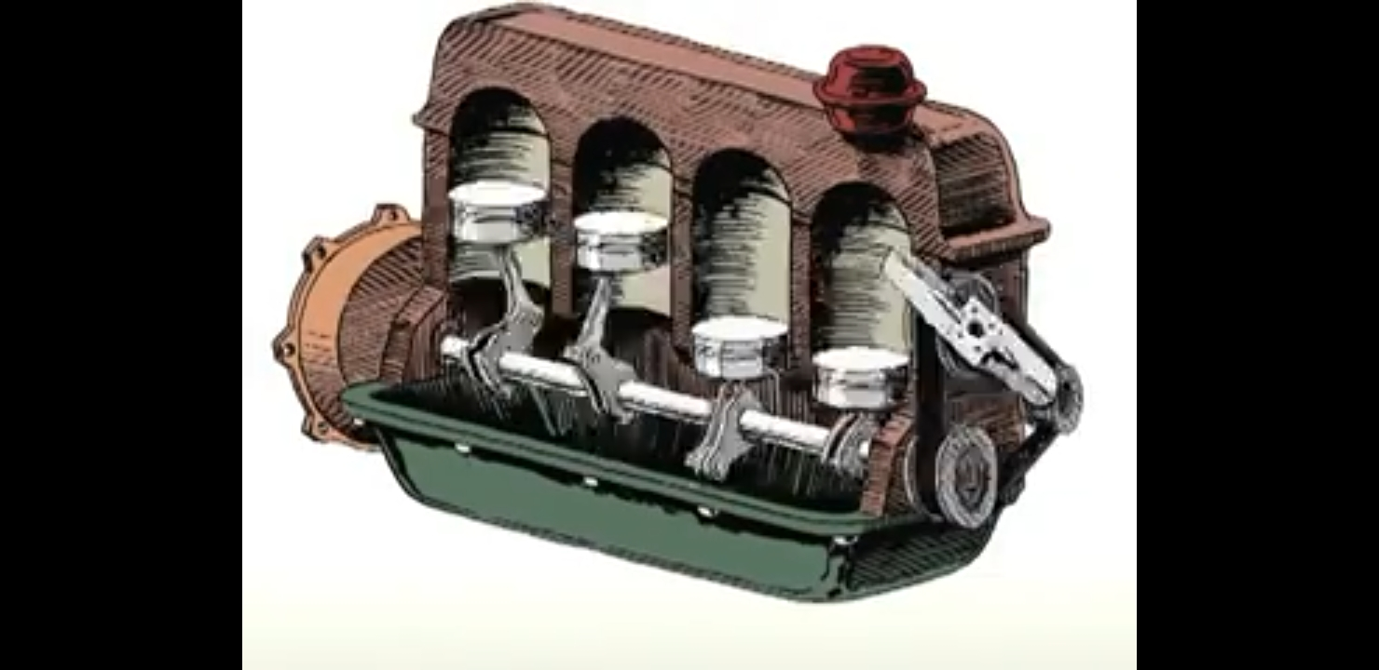

Slide 7
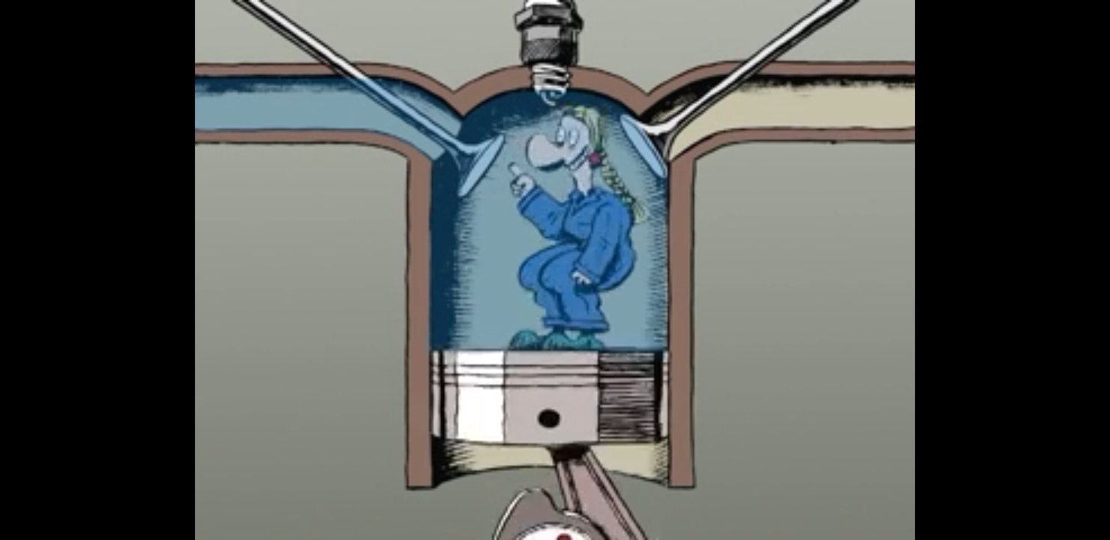

Slide 8
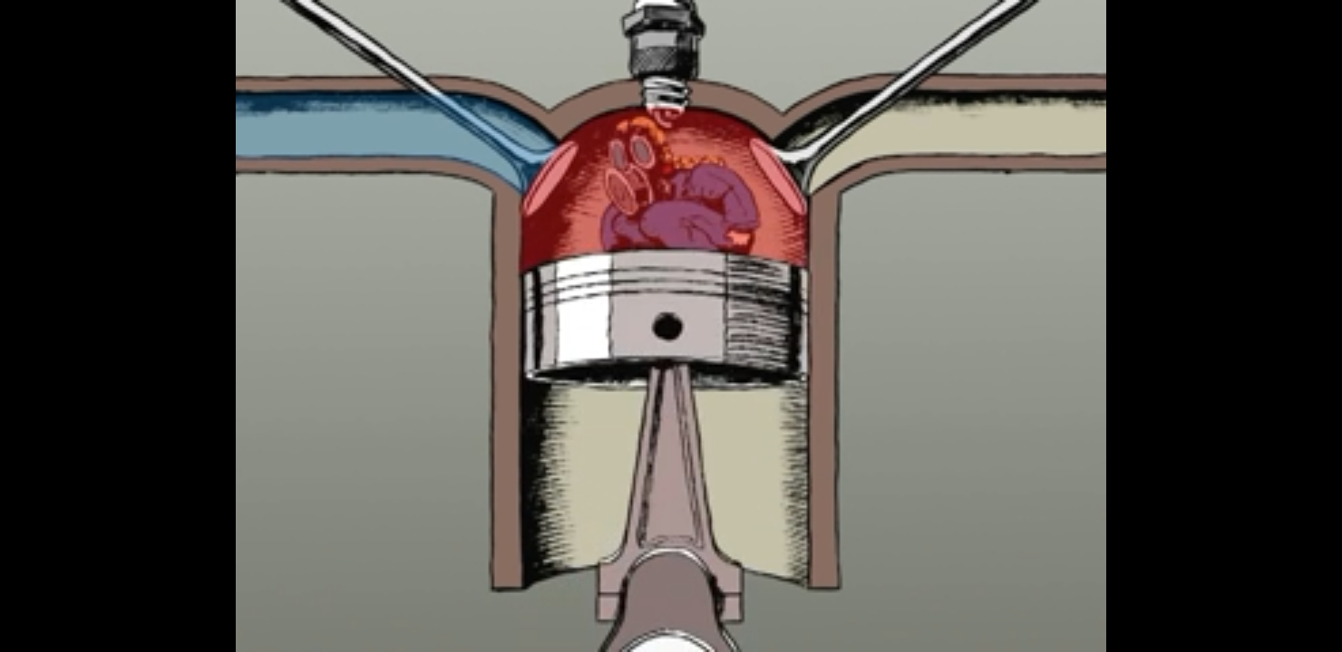

Slide 9
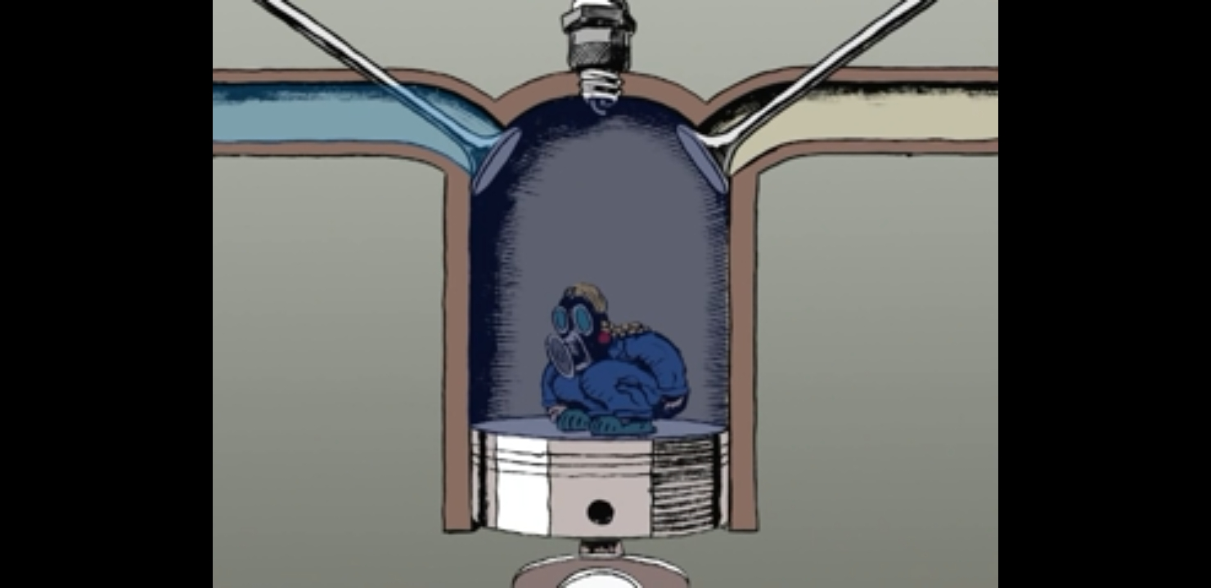

Slide 10
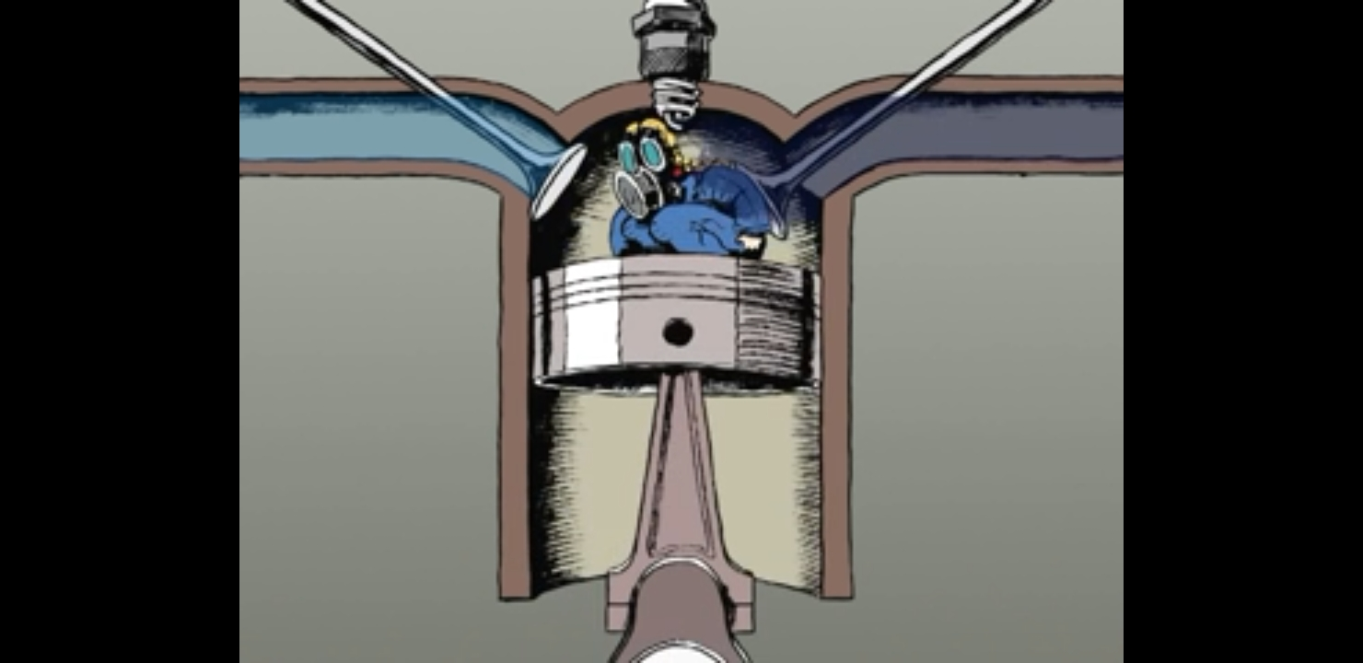

Slide 11
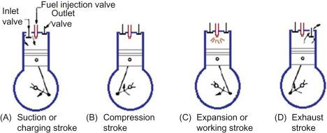

Slide 12
4 – Stroke Petrol Engine
1st stroke –
Intake/Suction stroke Stroke – Air-Fuel mixture is sucked into the combustion chamber through an open inlet valve, when the piston moves from Top Dead Center (TDC) to Bottom Dead Center (BDC)

Slide 13
4 – Stroke Petrol Engine
2nd Stroke–
Compression Stroke – Piston moves from BDC to TDC, compressing the air fuel mixture to a very small space. Both inlet and outlet valves are closed.

Slide 14
4 – Stroke Petrol Engine
3rd Stroke–
Expansion/Power Stroke – Park plug gives a spark to the compressed air-fuel mixture. The fuel burns. Piston is rapidly pushed down to BDC. Both valves are closed.
The power for entire engine functioning and vehicle movement is obtained from power stroke.
These types of engines are called Spark Ignition Engines. (SI Engines)

Slide 15
4 – Stroke Petrol Engine
4th stroke –
Exhaust Stroke – Outlet valve opens. The piston moving from BDC to TDC pushes the burned exhaust gases out of the combustion chamber.

Slide 16
Notes
The thermodynamic cycle of petrol engine is called , Otto Cycle.
Similar to this, there is 4-stroke diesel engine
Also 2-stroke petrol and diesel engines are also available.
Diesel engines do not have spark plug. Instead, ‘fuel injector’ sprays, diesel to compressed air. Compression Ingnition (CI) engines.

Slide 17
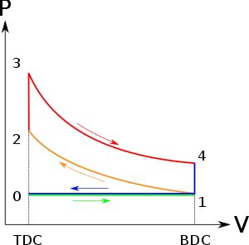
Otto Cycle

Slide 18
Otto Cycle – 4 main processes
1-2 – Adiabatic Compression
2-3 – Constant Volume Heat Addition
3-4 – Adiabatic Expansion
4-1 – Constant Volume Heat Rejection
* Adiabatic process = Process with no heat transfer/heat exchange. Sometimes, when this process is reversible, it is also called isentropic process. * Constant Volume Process = Isochoric Process * Processes 0-1 and 1-0 are additions to an otto cycle, for functioning of an engine.

Slide 19
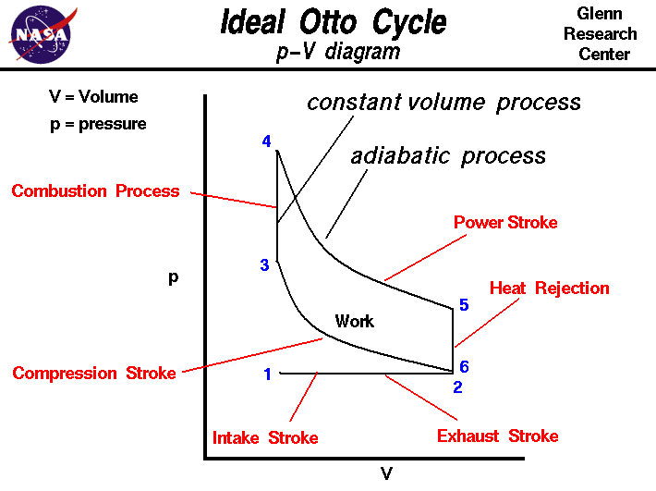

Slide 20
THANK YOU

